Slide 1

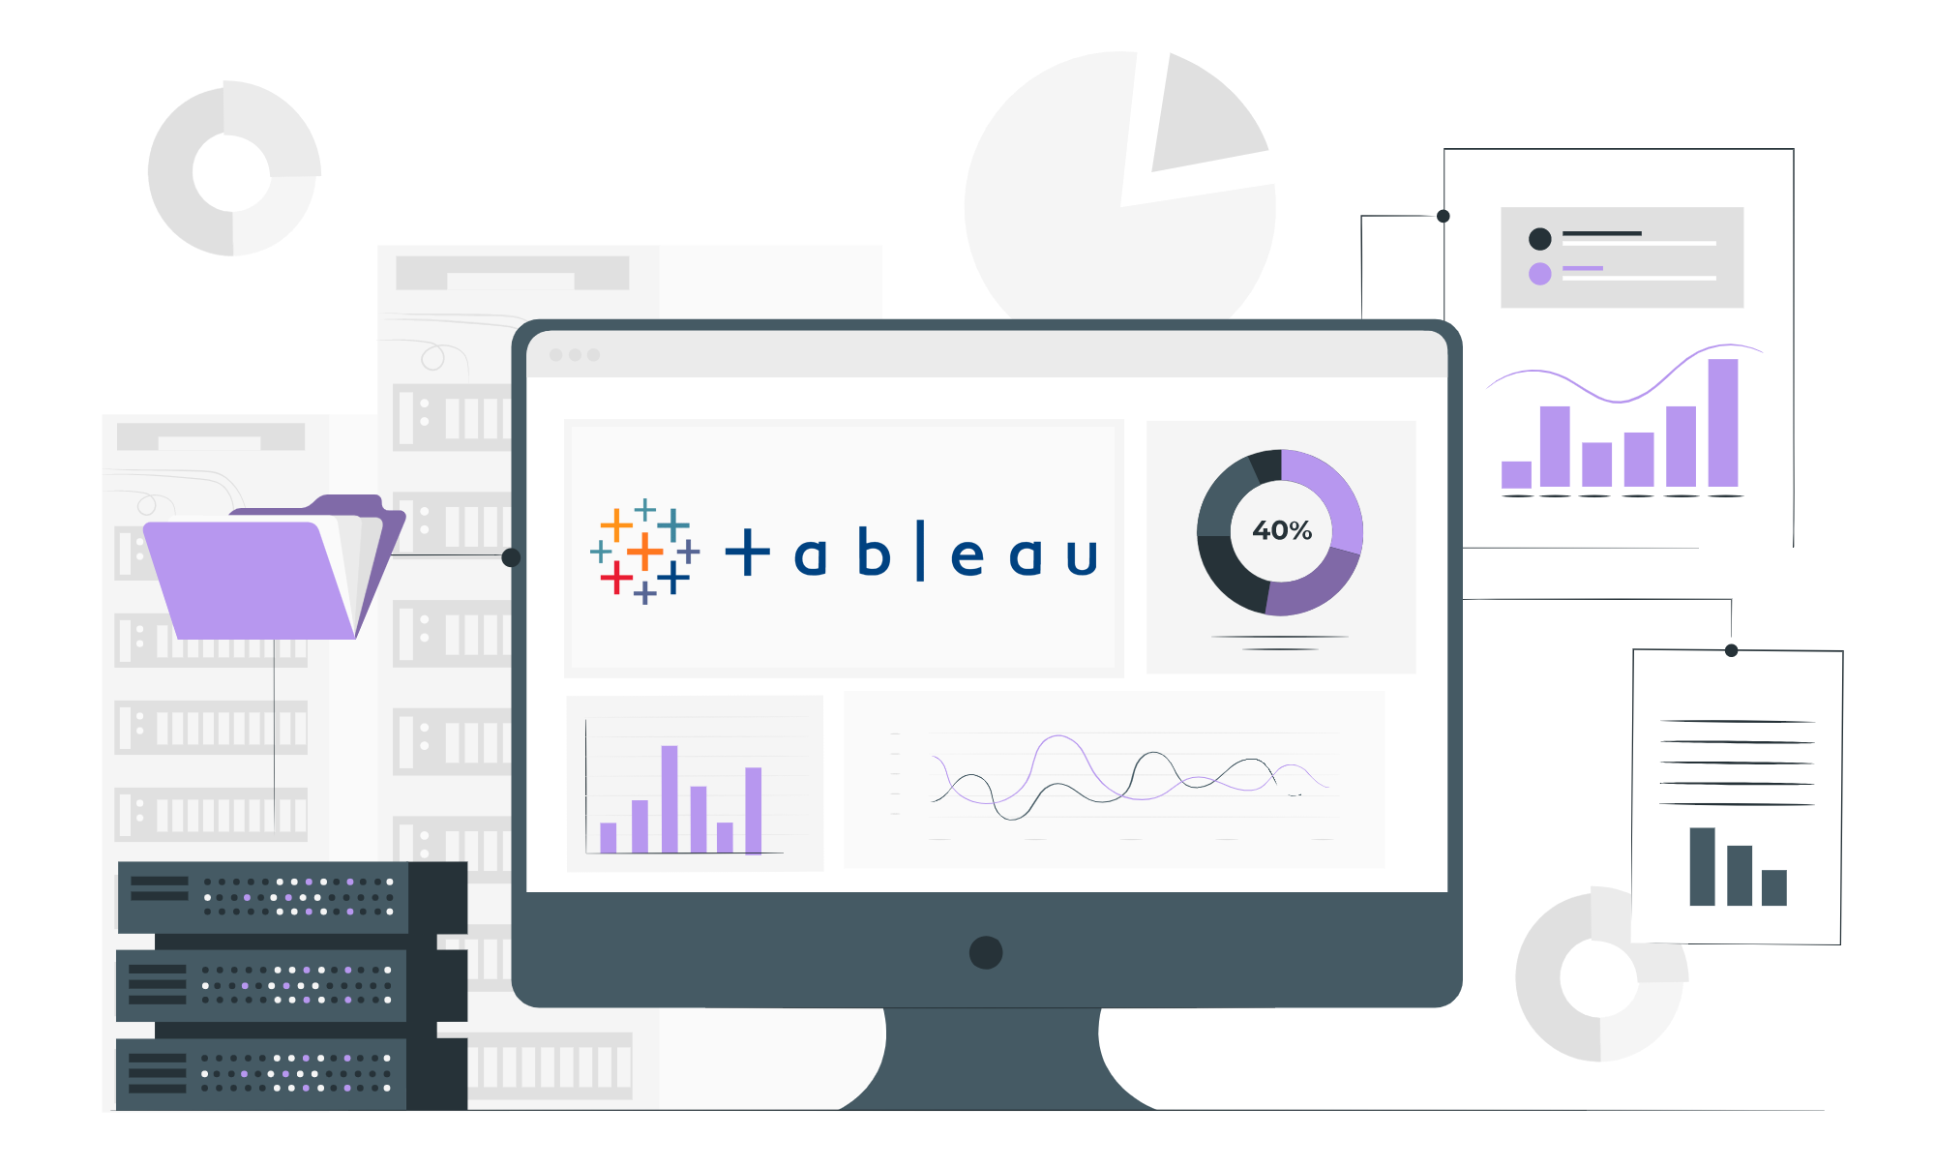
TABLEAU

Slide 2
Lecture CheckList
Business Intelligence
Tools and methodologies used in BI
Importance of Visualization
Future business impact of BI
Why Tableau?
Gartner’s Magic Quadrant
Tableau Product Suite
Tableau Architecture
Tableau installation in local system

Slide 3
What is Business Intelligence?
BI is a technology-driven process that analyses data and provides actionable information, for better decisions.
Aim - Drive a positive change to improve the company's performance and revenue.
BI encompasses a variety of processes such as data mining, data analysis, KPIs, visualisations, etc.
By using data to answer questions about the company's past and present, business intelligence significantly improves how a company arrives at its decision-making.

Slide 4
Methodologies used in BI
Basic Methods used :-
Data collection – Surveys, Questionnaires, Forms, etc.
Data visualization and Analysis
Reporting
Dashboards
Decision-making

Slide 5
Who uses BI and why?
People from departments like - sales, marketing, finance, operations, data science, data analysis, etc.
Tasks include - Statistical analysis, performance measurement against business objectives, gaining customer insights, and communicating data to identify better future opportunities.

Slide 6







Some tools used in BI
Power BI
Tableau
Qlik
Dundas BI
Talend
Sisense
Oracle BI

Slide 7
Future impacts of BI
- Business intelligence (BI)'s future and the future of data are inseparably linked.
- As the amount of data created and consumed by businesses grows exponentially, the quickness and convenience with which you can obtain and rely upon that data will be of greater significance than ever before.
Forecast market trends and consumer preferences
Predict unforeseen challenges
Data into Profits
Predictive Analysis
Better data-driven decision-making
Time efficient
Notes:
BI Market Size is Expected to Reach US$33.3 Billion by 2025.

Slide 8
Data visualization

Slide 9
Data visualization
Data visualisation is the graphical depiction of information and data.
A form of visual art that captures our attention.
The tools which include visual components like charts, graphs, maps, etc. come in handy to view and understand trends, outliers, and patterns in data.
Furthermore, it allows employees or entrepreneurs to communicate facts to non-technical people without creating confusion.
Data visualisation tools and techniques are critical in this Big Data age, for analysing huge volumes of data and making data-driven (strategic decisions based on data analysis and interpretations) decisions.

Slide 10
Benefits of data visualisation
Colours and patterns catch our attention.
Humans can quickly distinguish between red and blue, as well as squares and circles.
When we look at a chart, we immediately spot trends and outliers.
If you can't find a trend when you look at a huge spreadsheet of data, visualisation becomes important.
Also, with visualization, information can be shared quickly and easily.

Slide 11
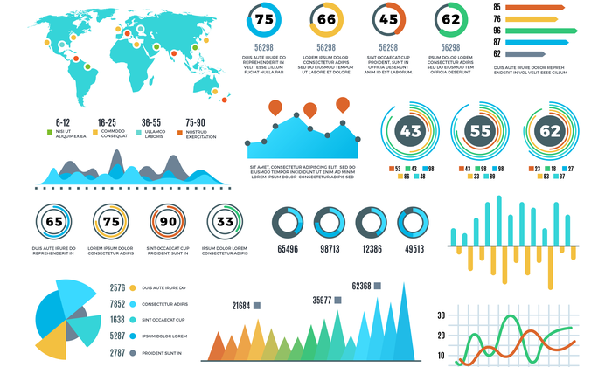
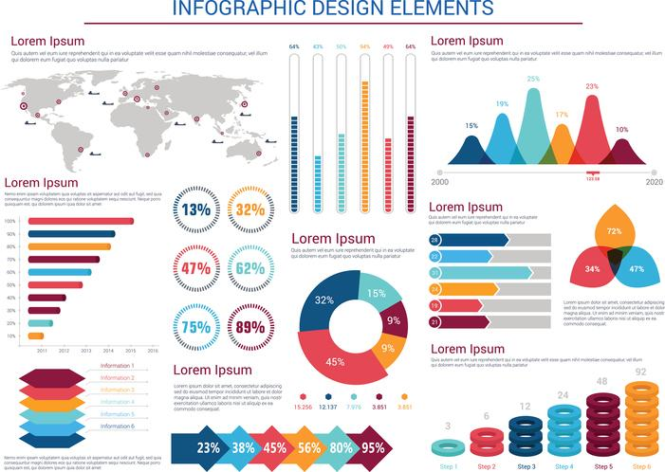

Slide 12
Tableau
Tableau is a highly effective and rapidly expanding data visualisation application used in the Business Intelligence Industry.
It aids in the simplification of raw data very much clearly.
Tableau assists in the creation of data that can be grasped by people at all stages of an organisation.
It analyses data swiftly and delivers visualisations in the form of dashboards and workbooks.

Slide 13

System requirements
Microsoft Windows 8/8.1, Windows 10 (x64)
4 GB memory
1.5 GB minimum free disk space
CPUs must support SSE4.2 and POPCNT instruction sets
MacOS Mojave 10.14, macOS Catalina 10.15, macOS Big Sur 11.4+,
and macOS Monterey 12.6+ (for Tableau 2022.3+) Intel processors
M1 processors under Rosetta 2 emulation mode
1.5 GB minimum free disk space
CPUs must support SSE4.2 and POPCNT instruction sets

Slide 14
Tableau product suite
Tableau desktop
Tableau Cloud
Tableau server
Tableau public
Tableau reader
(Tableau prep – ETL tool)

Slide 15
Tableau product suite

Slide 16
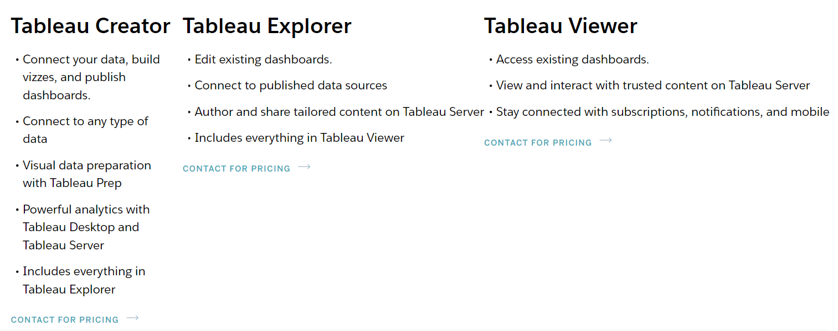
Tableau product suite

Slide 17
Tableau Architecture
Tableau architecture comprises :-
Data Server/Sources (75+)
Data connector
Tableau Server
Clients – web, mobile, desktop

Slide 18
Why use Tableau?
User-friendly
High performance
Quite speedy
Pretty convenient-to-use
Interactive
Easy publishing
Rich visualizations

Slide 19
Why use Tableau?
Huge Data handling
Low cost
Easy publishing
Direct connection with multiple databases
Simple drag-and-drop
Gartner’s magic quadrant – one of the best

Slide 20
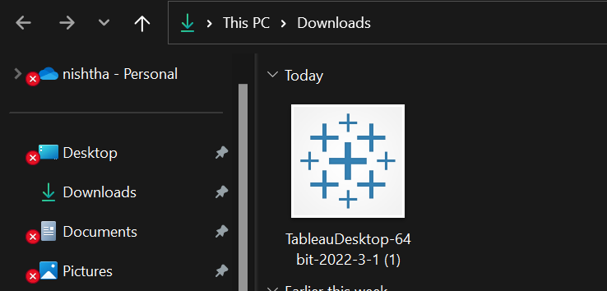
Install Tableau

Slide 21
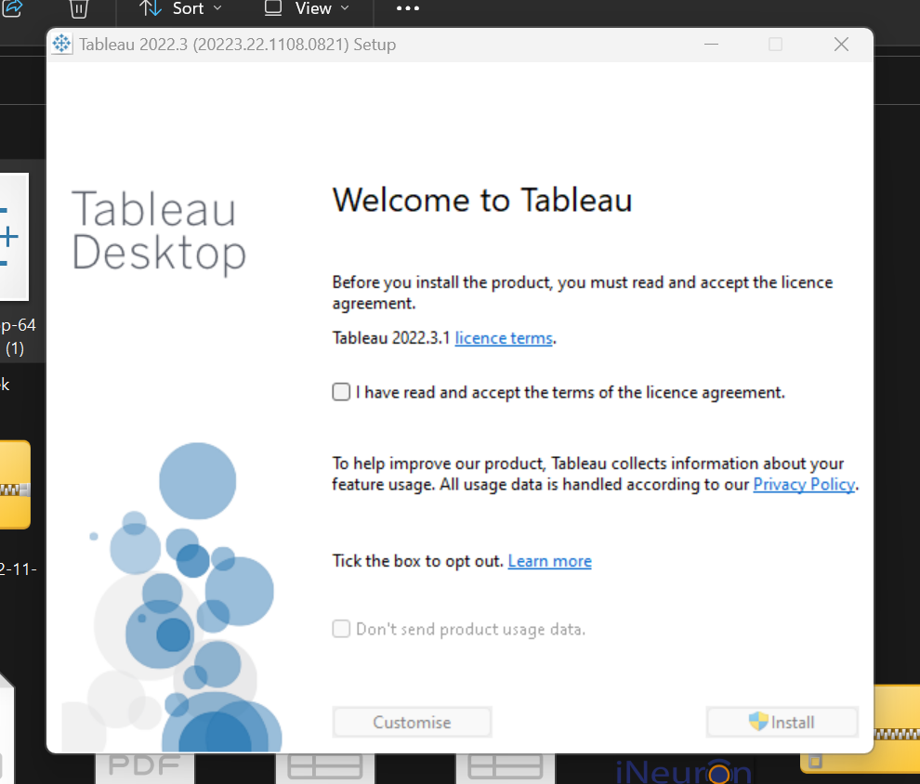
Install Tableau

Slide 22
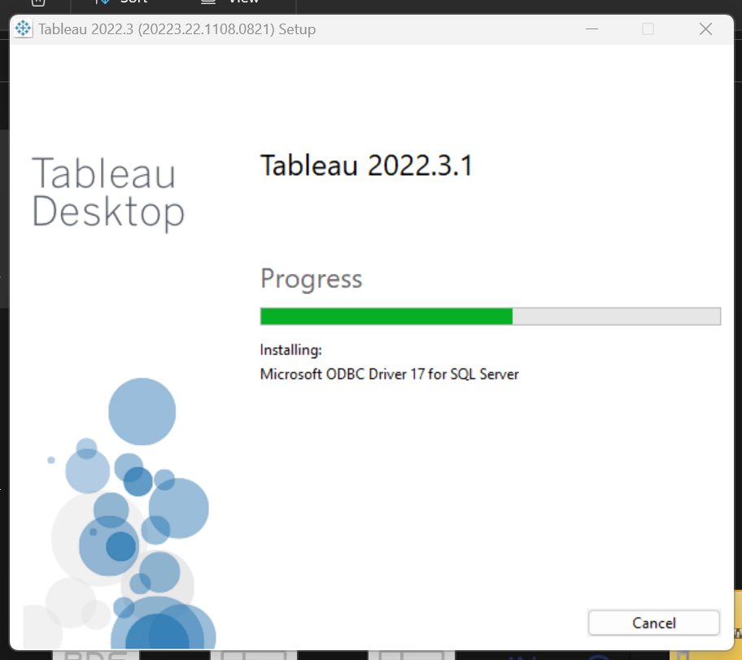
Install Tableau

Slide 23
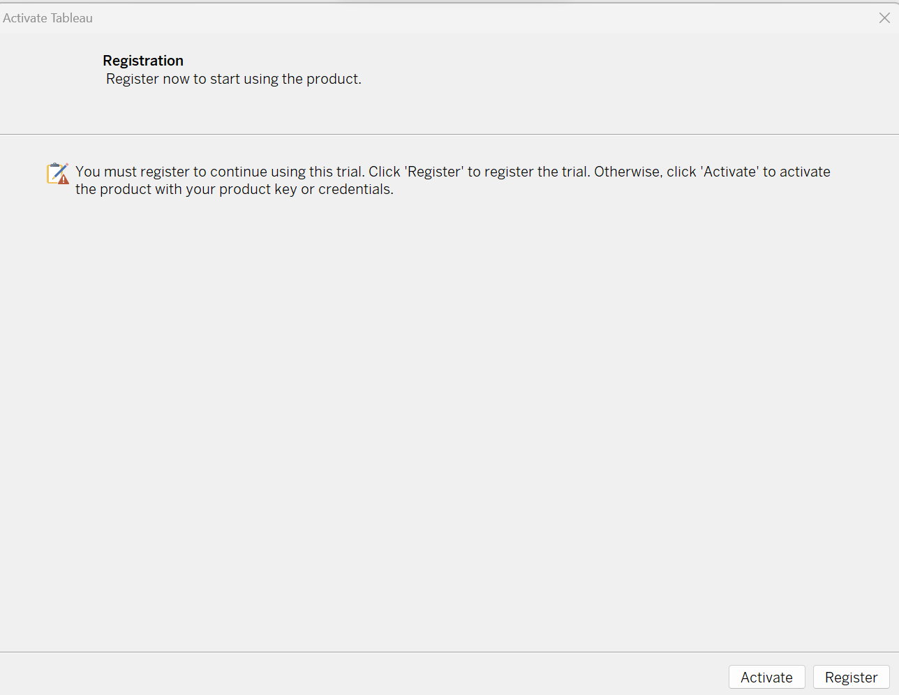
Install Tableau

Slide 24
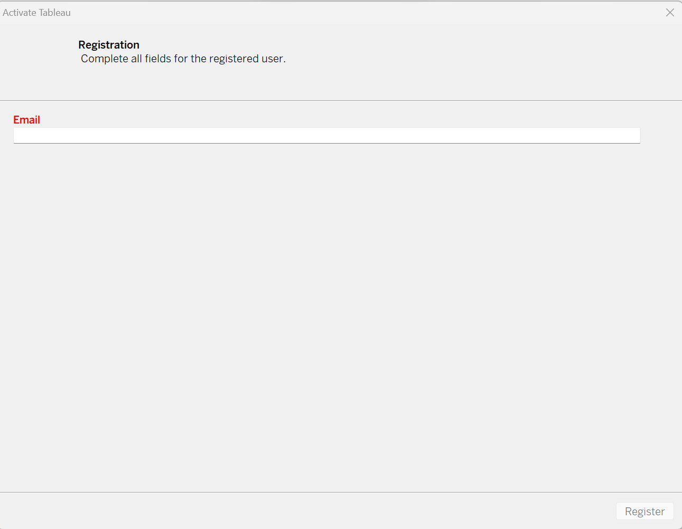
Install Tableau

Slide 25
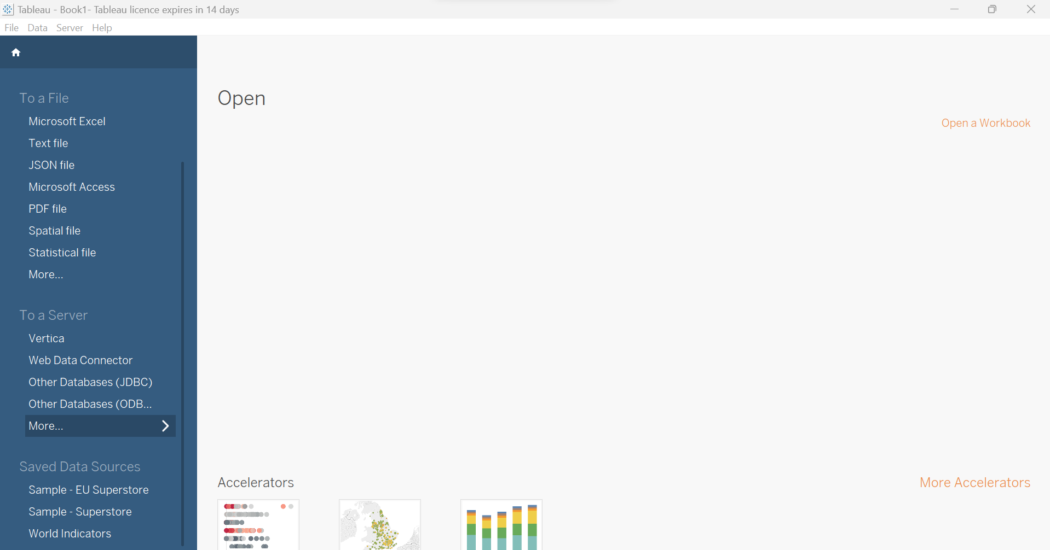
Tableau installed

Slide 26
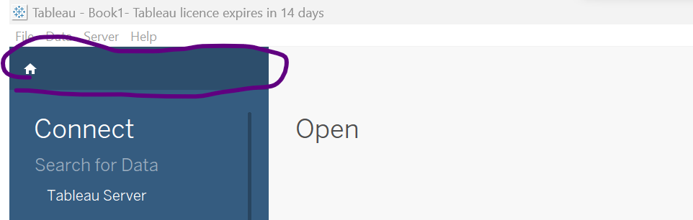
Opening A New Workbook

Slide 27
THANK YOU

